Slide 1


Slide 2
Meet the Team
Claire Thompson, Firangiz Ganbarli, Emmy Richardson, Zoe Kulphongpatana, Olivia Romig

Slide 3

FILMIFY
Notes:
Filmify is a web application that takes a user’s spotify data and will give movie recommendations

Slide 5

FILMIFY
Song Data
Movie
Recommendations
Notes:
Filmify is a web application that takes a user’s spotify data and will give movie recommendations

Slide 6
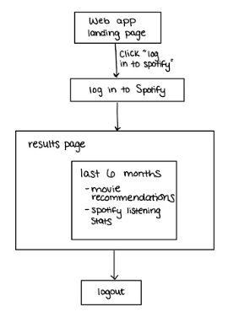
FILMIFY
UI Flow

Slide 7
Demonstration of UI

Slide 8
Demonstration of Spotify Backend Code

Slide 9


FILMIFY
APIs Used:
Spotify API
tMDB API

Slide 10






FILMIFY
No Videos
English
US Watch Region
4+ Stars
Popularity
40+ mins
Movie Filters:

Slide 11
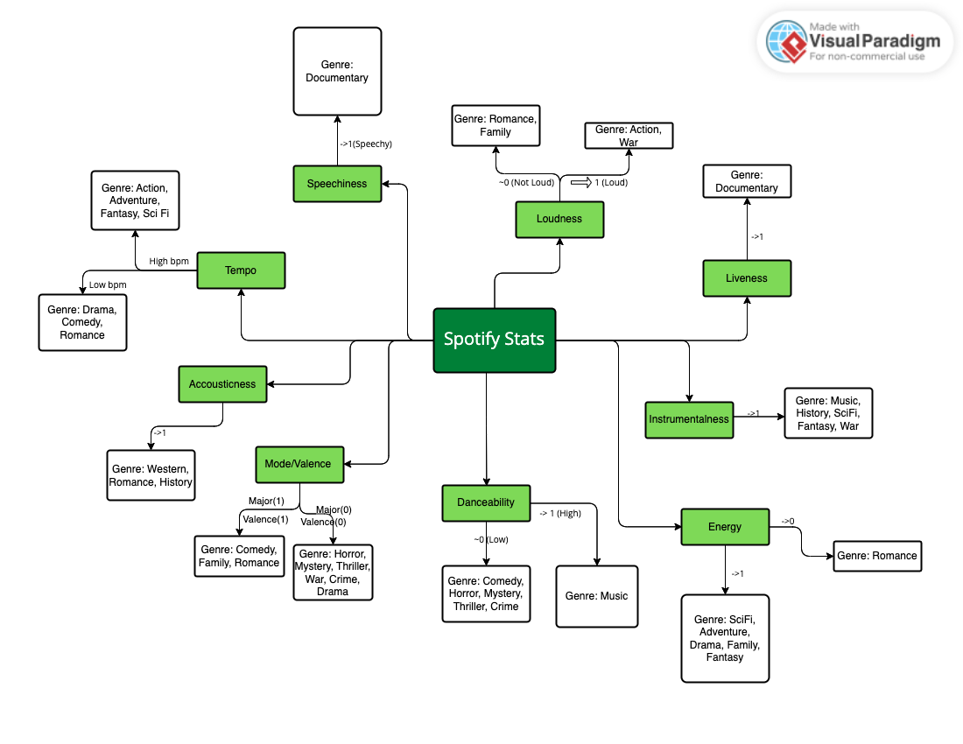
FILMIFY
a
Mapping Spotify Stats to Movie Genres

Slide 12
FILMIFY
Other mappings
Movie Soundtrack
Movie
Actor/Singer
Movie starring Singer
Singer
Biopic of Singer

Slide 13

FILMIFY
How would we map this song?
Valence | 0.914
Energy | 0.939

Slide 14

FILMIFY
How would we map this song?
Valence | Energy
0.914 | 0.939

Slide 15


FILMIFY
Recommendation Algorithm
should not map to
Technical Challenges:

Slide 16



FILMIFY
Recommendation Algorithm
Future plans:
Database
Additional Features

Slide 17
Thank You!
Any Questions?

